Slide 1
Euclidean (Euclid’s) Algorithm (for finding GCD)

Slide 2
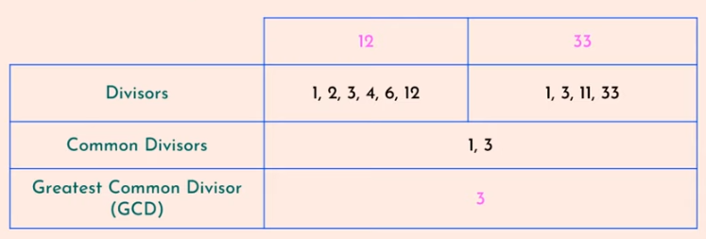
GCD-Example

Slide 3

Euclidean Algorithm for finding GCD (Method - 1)
Prerequisite: a>b

Slide 4
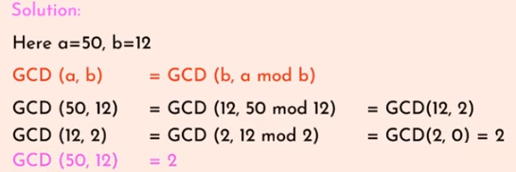
Example - 1
Find GCD (50,12)

Slide 5
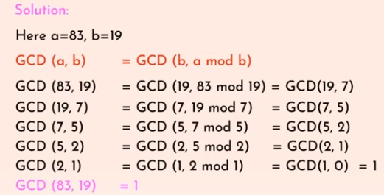
Example - 2
Find GCD(529,123)

Slide 6
Euclidean Algorithm for finding GCD (Method - 2)
gcd(A,B)=?
Draw the table with Q, A, B, R columns.
Ensure A > B.
Compute Q and R.
Shift B to A and R to B for next row.
Repeat until B = 0, then gcd(A,B) = A.

Slide 7
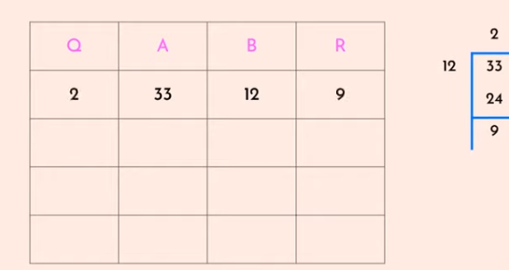
Step - 1
Find GCD (12,33)

Slide 8
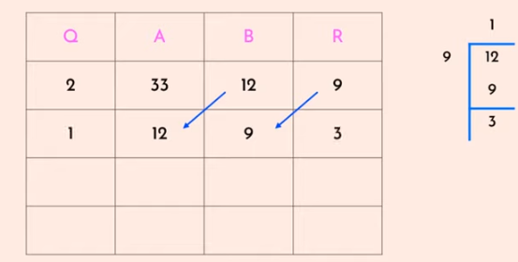
Step - 2

Slide 9
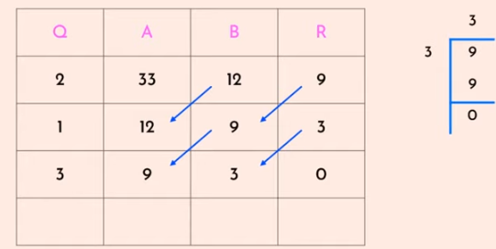
Step - 3

Slide 10
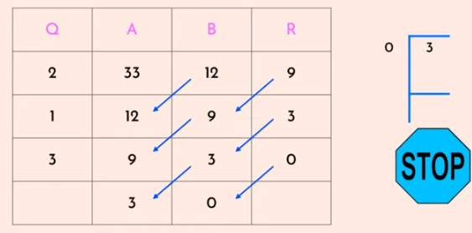
Step - 4

Slide 11
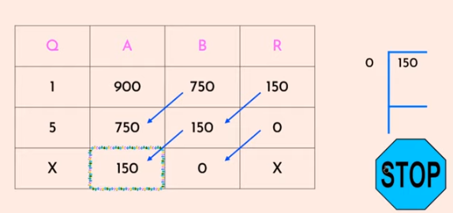
Example - 2
Find GCD (750, 900) using Euclid’s algorithm.

Slide 12
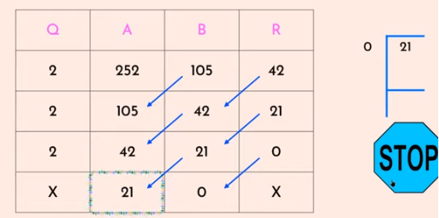
Example - 3
GCD(252,105)=?

Slide 13
Exercise
Find GCD of (1005, 105) using Euclid’s algorithm.
Find GCD (2740, 1760)
Find GCD (25, 60)

Slide 14
Extended Euclidean Algorithm

Slide 15
Extended Euclidean Algorithm
Finding gcd(a,b) and x,y.
Finding multiplicative inverse.

Slide 16
Extended Euclidean Algorithm – Finding gcd(a,b) and x,y
Given two integers a and b , we often need to find 2 integers x and y such that
ax + by = gcd(a,b)
So extended ecludian’s algorithm used to find gcd(a,b), and the values of x and y.

Slide 17
Steps
gcd(A,B) =? and x,y=?
Draw the table with Q, A, B, R, X1, X2, X, Y1, Y2, and Y columns.
Ensure A > B.
Assign X1=1, X2=0, Y1=0, Y2=1 for first row. Compute Q, R and X = X1-QX2 and Y=Y1-QY2
Shift B to A and R to B , X2 to X1, X to X2, Y2 to Y1, Y to Y2 for next row.
Repeat until B = 0, then gcd(A,B) = A, X = X1 and Y = Y1.

Slide 18
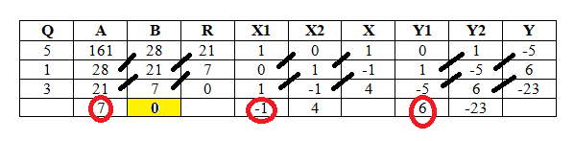
Example
Find the gcd(161,28) & the values of x and y.
Solution:
gcd(161,28) = 7
X = -1
Y = 6
NOTE:
ax+by = gcd(a,b)
161*(-1)+28*6 = gcd(161,28)
7 = 7 Hence Verified

Slide 19
Find the gcd(56,15) & the values of x and y
Ans:
GCD(56,15)=1
X=-4,y=15

Slide 20
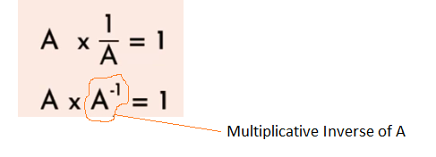
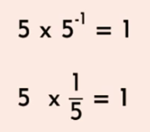
Extended Euclidean Algorithm – Multiplicative Inverse (M.I)
Example

Slide 21

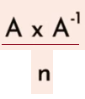
Modular M.I (M.I under modular arithmetic)
When , then we get 1 as remainder.
Definition: A modular M.I of an integer ‘a’ is an integer ‘x’ such that the product ‘ax’ is congruent to ‘1’ with respect to the modulus ‘m’.
ax ≡ 1 mod m
Where x is a multiplicative inverse of a.

Slide 22
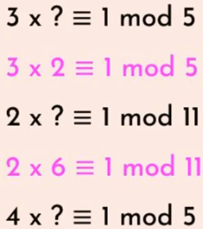

Modular M.I
Examples:
Consider, → No M.I exists, because 5 and 10 are not relatively prime.
If gcd(n1,n2) ≠ 1, then it means they are not relatively prime to each other in such cases we will never have a M.I.
3,5 are co-prime, therefore multiplicative inverse exist.

Slide 23

Modular M.I (Contd…….)
M.I of 2 (mod 5) is 3.
M.I of 2 (mod 7) is 4.
Find M.I using Extended Euclidean algorithm.

Slide 24
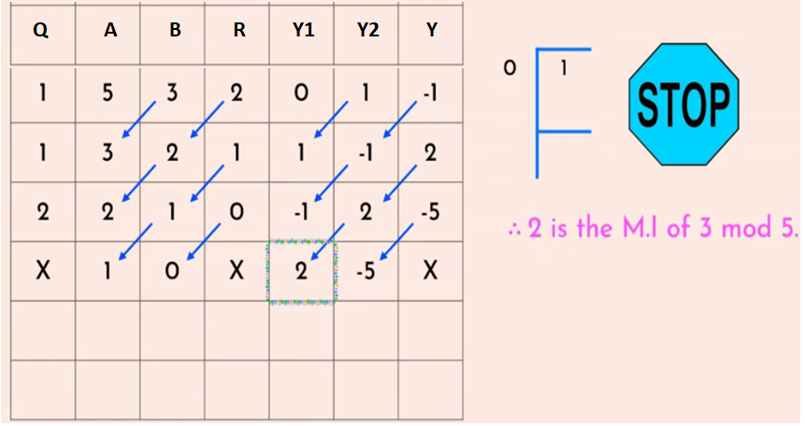
Example - 1
What is the multiplicative inverse of 3 mod 5?

Slide 25
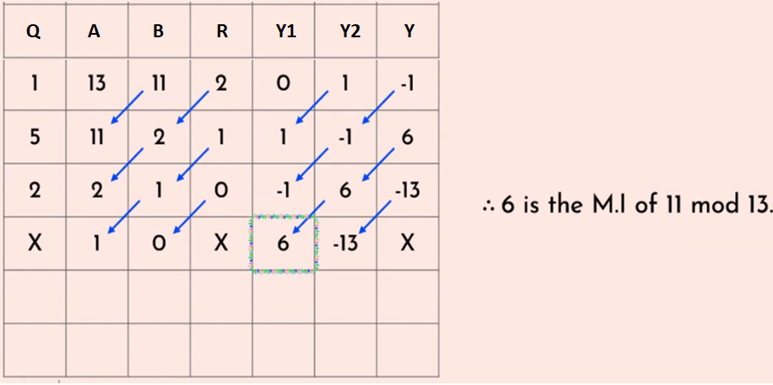
Example - 2
What is the multiplicative inverse of 11 mod 13?

Slide 26
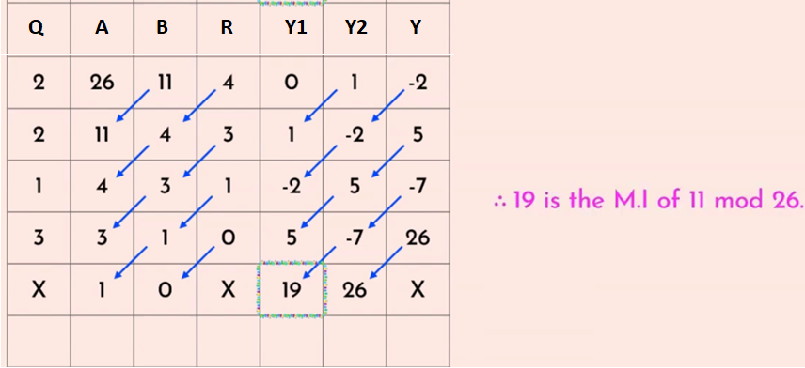
Example - 3
What is the multiplicative inverse of 11 mod 26?

Slide 27
Exercise
What is the multiplicative inverse of 10 mod 11?
Solution:
(10 x 10) % 11 = 1
-1 mod 11 = 10

